Slide 1
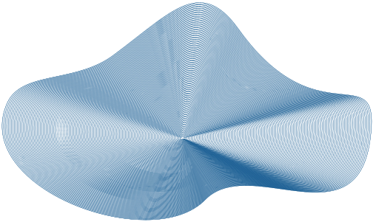


TELCO CUSTOMER CHURN ANALYSIS
BY AKOMA INTELLIGENCE

Slide 2

A major telecommunications company is experiencing customer churn, where customers are discontinuing their services at a significant rate.
Understanding the drivers behind customer churn is essential for improving customer retention and maintaining profitability.
AKOMA INTELLIGENCE

Slide 3


ABOUT US
At Akoma Intelligence, we combine the power of data with the soul of innovation.
Inspired by the Akan symbol Akoma — meaning “the heart” — we bring empathy, insight, and intelligence to the world of data and machine learning.
From predictive models to customer churn analysis, we deliver solutions that drive growth, shape digital transformation.
Let your data speak — with heart.

Slide 4


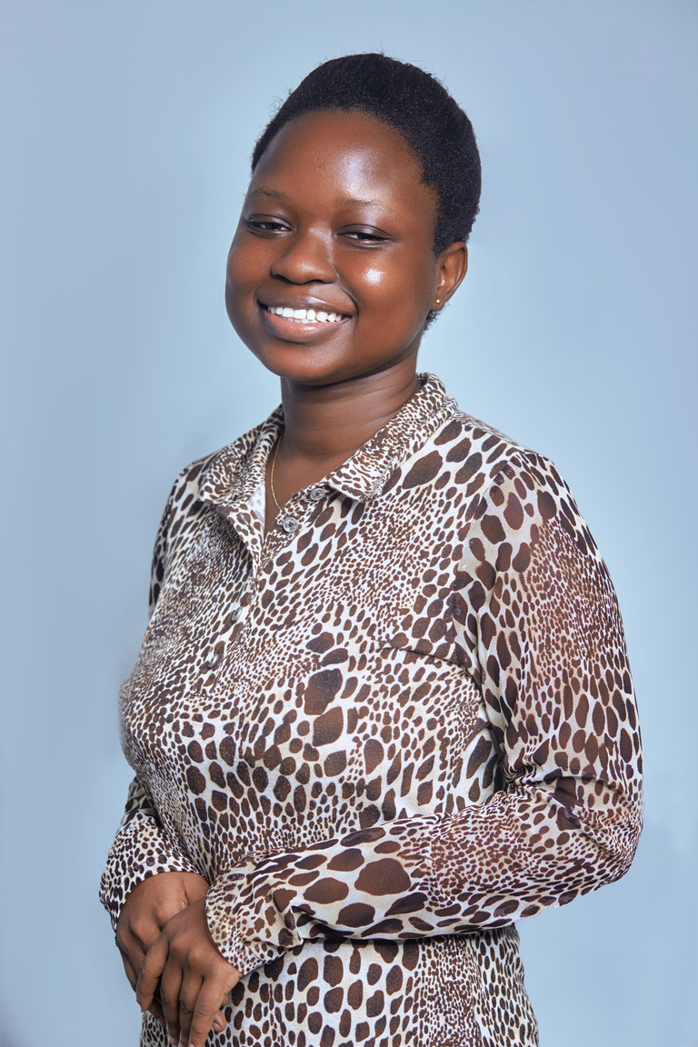


THE TEAM
KOBY
ADISENU
LYDIA
FORDJOUR
AKOSUA
MENSAH
MARY D.
ASARE
KAUSARA
KPABIA

Slide 5

UNDERSTANDING CUSTOMER CHURN
CHALLENGES
DATA
PROJECT GOALS
High customer churn threatens
profitability.
Understanding churn
drivers is key.
Internet Service
Monthly Charges
Tenure
Contract
Dependants
Identify churn patterns.
Build a predictive model
Improve customer retention

Slide 6




7032
TOTAL CUSTOMERS
$16.06M
TOTAL SALES
MARKET
SUMMARY
CHURN RATE

Slide 7
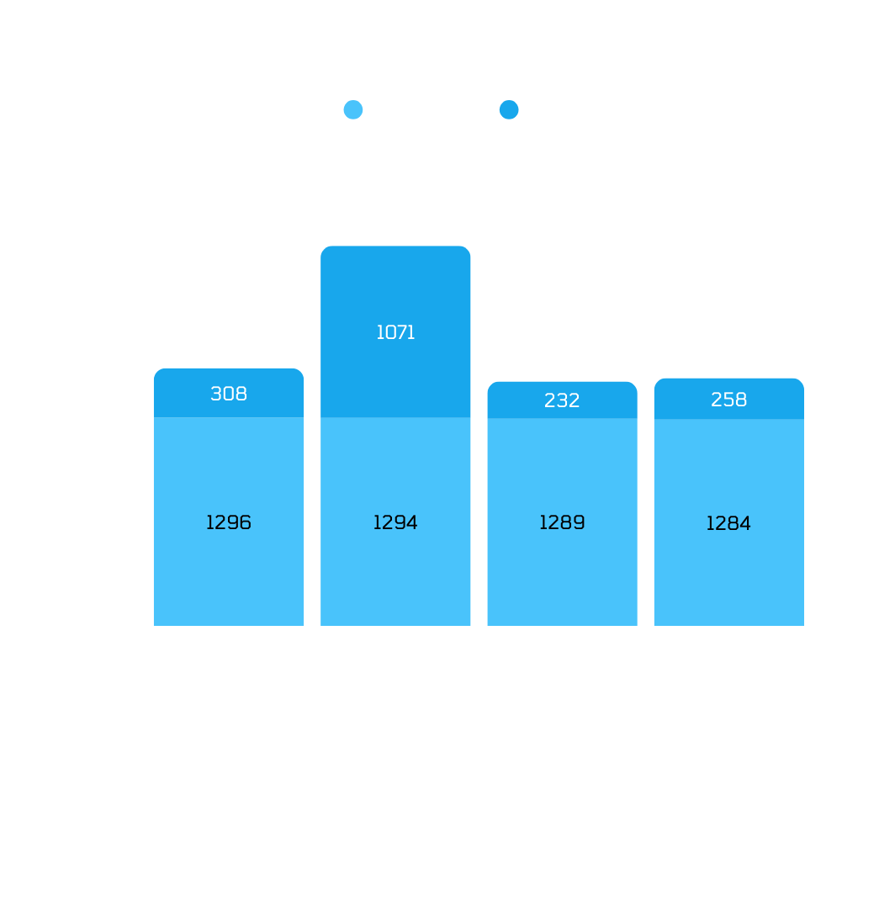

KEY INSIGHTS
PAYMENT METHOD
Electronic check payment method most preferred
Electronic check method has the highest churn rate 45%
Linked to Month-Month Contract hence the high
churn rate
Prominent among tech savvy customers hence little
tolerance for slight glitches

Slide 8
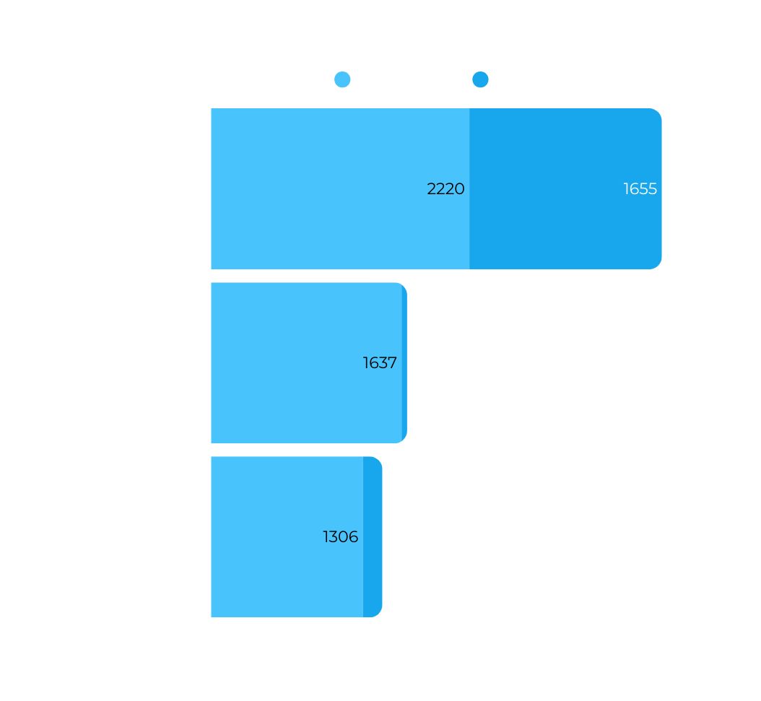

KEY INSIGHTS
CONTRACT
Shorter Contracts - Higher Churn rate
Shorter contracts speak to lower commitments hence ease of churning
Tried and tested out by new customers

Slide 9
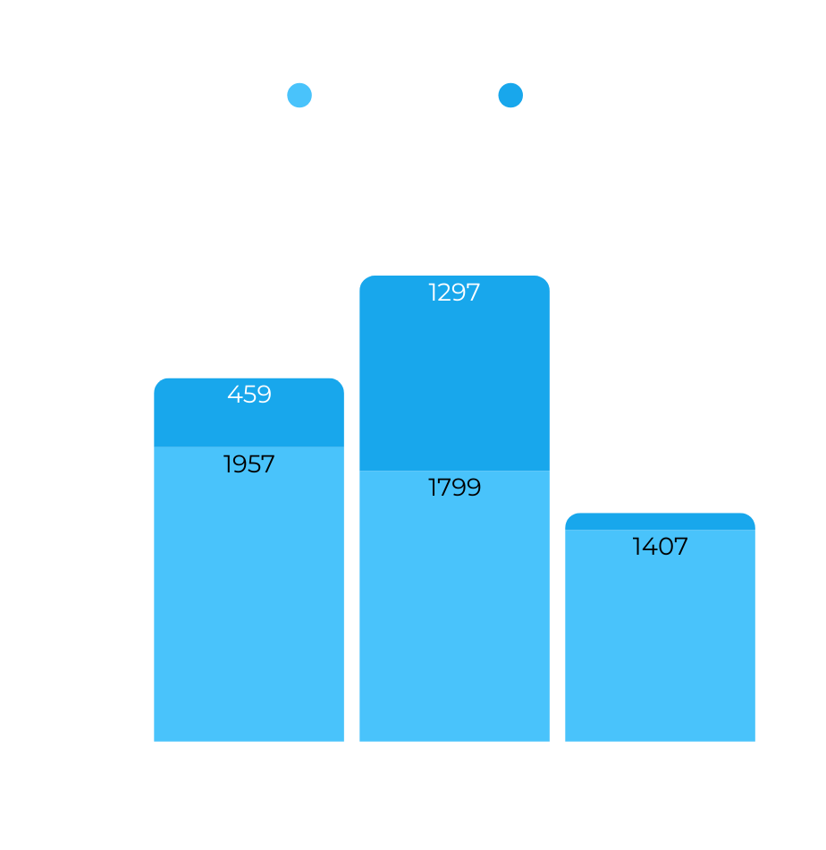

KEY INSIGHTS
INTERNET SERVICE
Most Customers enjoy Fiber Optic Internet, but struggle with payment.
High expectations of Fiber Optics users hence little tolerance for internet glitches
Competitive markets leading to hopping and switching customers

Slide 10
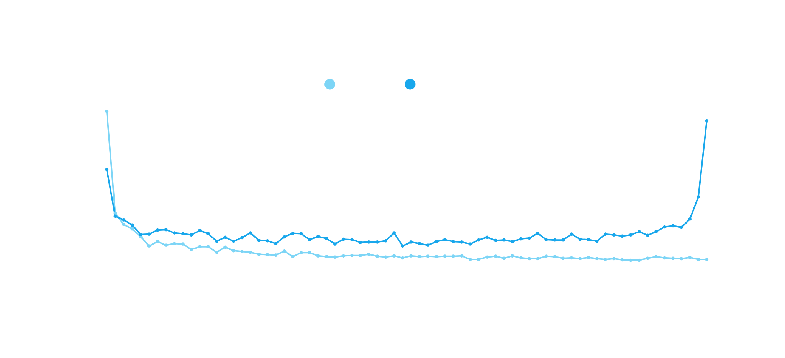
KEY INSIGHTS
TENURE
Longer tenure = lower churn rate
200+ increase in retained customers in last 2 months

Slide 11
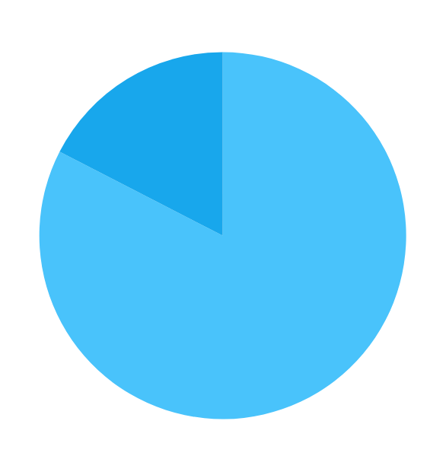




KEY INSIGHTS
DEPENDANTS
MONTHLY CHARGES
Higher charges leading to higher churn rate
Customers without Dependants churn more.
Less ties eg kids and spouses churn easily

Slide 12
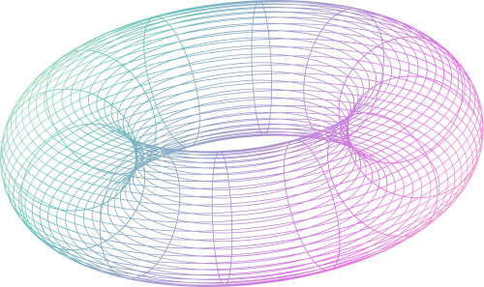


PREDICTION & MODELLING
Logistic Regression is our best performing model
Decision Trees
81.8%
Logistic Regression
83%
Random Forest
81.5%
ROC-AUC SCORE
XGBoost
80.4%

Slide 13


RECOMMENDATIONS
OFFER DISCOUNTS TO REDUCE CHURN RATE TO ABOUT 5%
ADDRESS CHALLENGES OF CHURN CUSTOMERS TO INCREASE RETENTION RATE BY 7%
RECEIVE FEEDBACK FROM ALL CUSTOMERS TO IMPROVE OUR SERVICES
RUN PROMOS AND CUSTOMER AWARDS MONTHLY

Slide 14

GET IN TOUCH
www.akomaintelligence.com
+233 20 892 6744
GW-0334-3613, Mile 7 Parks and Gardens,
Accra, GA

Slide 15
THANK YOU
AKOMA INTELLIGENCE

